Slide 1
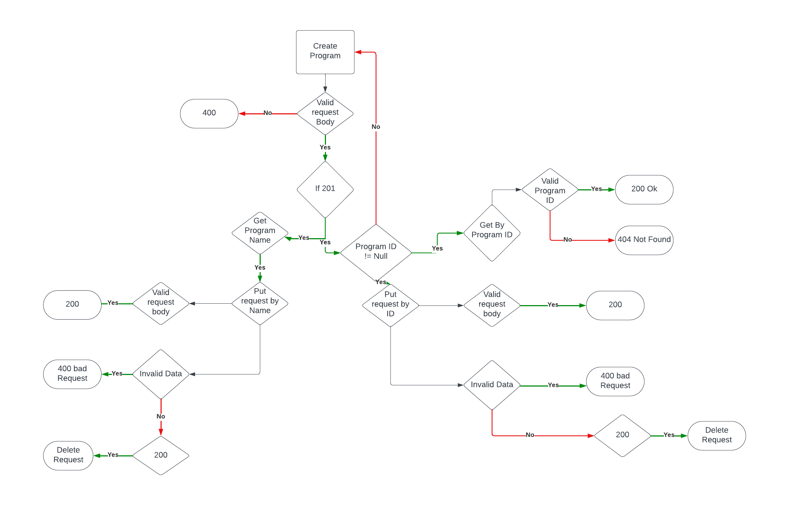
Program Module Framework Plan

Slide 2
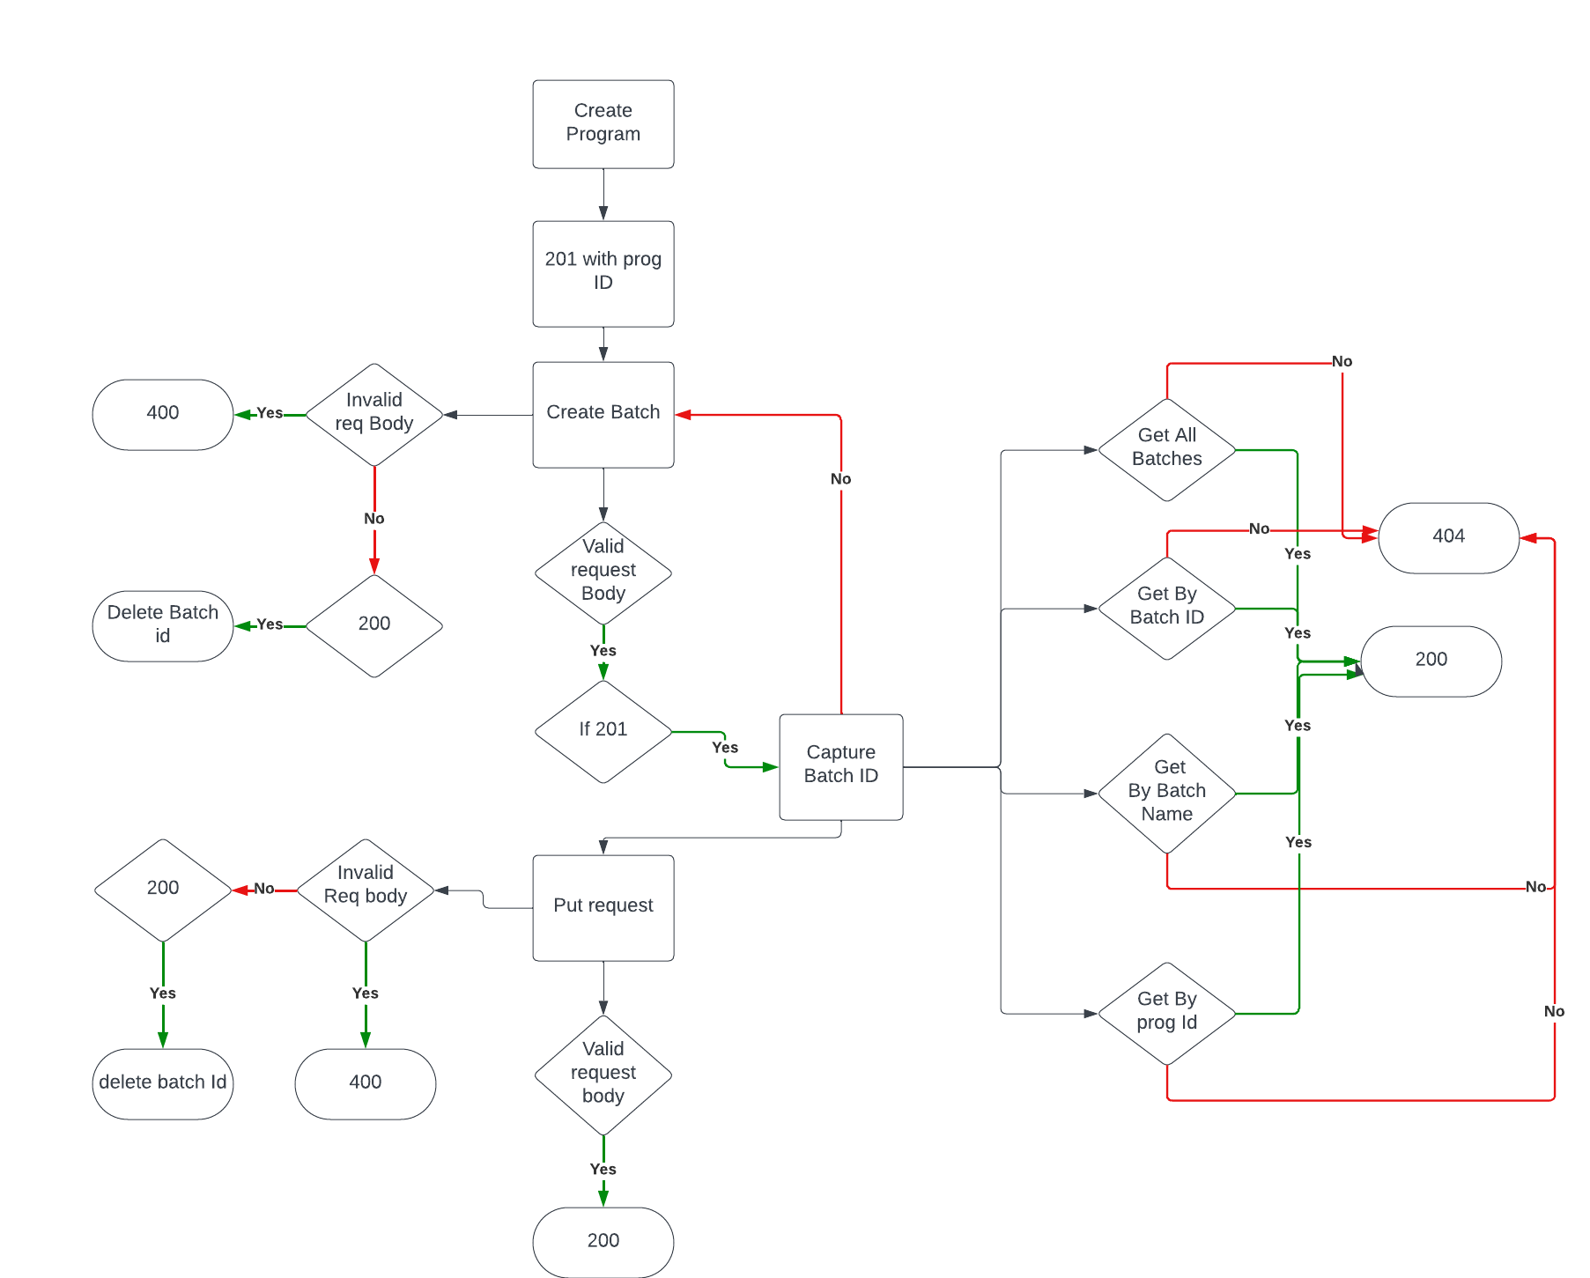
Batch Module Framework Plan

Slide 3
Feature File Names : Batch
TC07_Post_Batch.feature
TC08_Get_Batch.feature
TC09_Put_Batch.feature
TC10_Delete_Batch.feature
Step Def : Batch
- TC07_Post_Batch
- TC08_Get_Batch
- TC09_Put_Batch
- TC10_Delete_Batch
Methods for Batch
- TC07_Post_Batch_Methods
- TC08_Get_Batch_Methods
- TC09_Put_Batch_Methods
- TC10_Delete_Batch_Methods
Pay load JSON
HashMap req_Body = new HashMap();

